Slide 1
How to Use This Presentation

Slide 2
Introduction
As an advocate and champion of family learning, this presentation is intended to serve as inspiration and a launchpad to lead a family discussion on how to begin building a family learning program.
What to Expect:
Content to build shared understanding of what family learning is and why it is important
Discussion questions to gather key data to inform next steps for learning program design
Examples of what other family offices have done
What NOT to Expect:
A ready-to-use family learning program or curriculum
One-size-fits all guidance. “If you have seen one family office, you have seen one family office” after all
How to Use the Presentation:
Add, delete, modify slides and notes to fit your context based on your goal(s) of delivering this presentation; consider updating the “How Do We Begin” section with your proposed plan for next steps or key questions needed to get started
Capture what is shared and use the data/information to develop your family learning program
Consider breaking up the deck to suit your needs. For example, sections could be used across several learning committee meetings or used to structure the agendas for education committee meetings.

Slide 3
The Importance of Family Learning
Developing Flourishing Families through Continuous Learning
Notes:
Talking Points:
Facilitator sets up the presentation by introducing the topic and tying to either a personal family story or how the family came to this point to discuss family education.
Facilitator should set the expectations for the meeting.
Facilitator should communicate “what’s in it for the participants”, why is this important.

Slide 4
Meeting Agenda
1. Why is Family Learning Important?
2. What Does Family Learning Entail?
3. How Do We Develop a Family Learning Program?
4. How Do We Begin?
Notes:
Talking Points:
Meeting agenda
“Why is education important” - we are going to put education in context for the family and the individual.
“What does family learning entail” section we will define family learning and look at components of a learning program.
“How do we develop a family learning program” - we will look at common goals, practices and challenges in family education today as inspiration to think about what we might want to include in our own program.
“How do we begin” - we will explore best practices, challenges and next steps for creating our family learning program
What’s in it for the attendee?
Understand why education is important and how it can benefit the family, gain a foundation to create objectives for your education program and identify next steps to beginning an education initiative.

Slide 5
Why Family Learning is Important?

Slide 6
Definitions
Definition of Family Learning
“When you prepare yourself to be a good owner, you are creating the opportunity for yourself to contribute. You are finding the way to earn what you own by being a good steward of it – preserving and building it for the next generation, for employees, and for the community.”
How to Be an Effective Shareholder, Craig E. Aronoff, Ph.D. and John L. Ward, Ph.D
Family learning is the process of gaining knowledge and expertise that supports family members’ ability to personally thrive AND meaningfully participate in the family enterprise.
Additional characteristics:
Involves more than one generation
Has clear learning objectives and outcomes
Can be formal (e.g. financial literacy course) or informal (fun, family activity)
Definition of Family Enterprise
Collection of entities that a family stewards, including businesses, investment capital, philanthropic capital, and recreational capital they own.
Notes:
Talking Points
We will dig more deeply into “What” family learning is in the next section, but let’s start by aligning ourselves around a shared definition.
Family learning is the process of gaining knowledge and expertise that supports family members’ ability to personally thrive AND meaningfully participate in the family enterprise.
Involving more than one generation – while certain learning experiences may target a particular generation, learning is a continuous and lifelong process for the entire family
Learning objectives and outcomes – we naturally learn all the time, but intentional family learning requires defined learning objectives and desired outcomes that will enable the achievement of family and individual goals
Formal or informal – we often think of learning/education occurring through school, formal courses and certificates. However, powerful learning also happens during regular family engagement where an opportunity exists to absorb family history, values, qualities, etc. that made founders successful.

Slide 7
Family Learning is Continuous and Two-Way
Family learning programs generally (and rightly) focus on Rising Gen learning, because they are growing up! At the same time, families should create a culture of learning that supports continuous learning across and between the generations, that includes both family led learning and external education.
Mentoring + Exemplifying
Family-Led Learning
Family History
Family Vision / Mission / Values
Entrepreneurship
Governance and Board Training
Responsible Ownership and Engagement
External Education
Finance
Leadership Skills
Personal Identity and Growth
New industry and career skills and knowledge
Reinforcing + Amplifying + Innovating
Notes:
Talking Points
Family learning programs generally (and rightly) focus on Rising Gen learning, because they are growing up!
However, they should also create a culture of learning, which encourages continuous learning across all generations, and through both family led learning as well as external education.
Family led learning passes on family-held knowledge, skills and behaviors along with the family’s history, vision, mission and values through mentorship of the next gen as well as exemplifying desired/expected family behavior.
External education formally builds the skills family members need to participate in the family enterprise in addition to supporting their ability to self-actualize. This is also where the rising gen bring back to the family new skills and ideas that promote iteration and innovation to promote continued family enterprise success over time.
Discussion Question
What examples can you share of how you have taught the next generation?
What about how they have shared new insights with you?
How are you creating an environment where generations share and learn from one another?
Where do you provide opportunities for family-led learning and how are you offering external education?

Slide 8
Learning Delivers Value to the Family and the Individual
For the Family Enterprise
Family Engagement
Improves quality of family discussions
Increases family engagement
Leadership Development
Facilitates identification and development of family leaders
Developing the whole person contributes to family flourishing
Family Success & Legacy
Serves as a key part of the glue that holds a family together
Reinforces family history, vision and values throughout generations
For the Individual
Purposeful Life
Supports finding place in family and life purpose
Builds the behaviors, skills and competencies to lead a purposeful life
Credibility
Supports career exploration and development
Provides opportunity to demonstrate abilities to the family
Self-Confidence
Enhanced knowledge and experience builds confidence in ability to achieve
Deepens knowledge of and security in oneself
Notes:
Talking Points
Invite participants to brainstorm their own reasons to educate family members.
Reminder: capture what is shared and use data/information in next steps to develop your family learning program. Reference the FOX Family Learning Handbook to learn more about how to develop your family learning program.

Slide 9
Education Promotes Family Sustainability
Build Family Cohesion: Prevent “Shirtsleeves to Shirtsleeves in Three Generations”
Notes:
Talking Points
The shirtsleeves to shirtsleeves in three generations adage comes true partly as a result of family cohesion breaking down. Lack of sustained shared values and poor communication contributes to that family breakdown. Family education promotes adoption of joint values, develops communication skills, and is reinforced through joint family learning that leads to that cohesion.

Slide 10
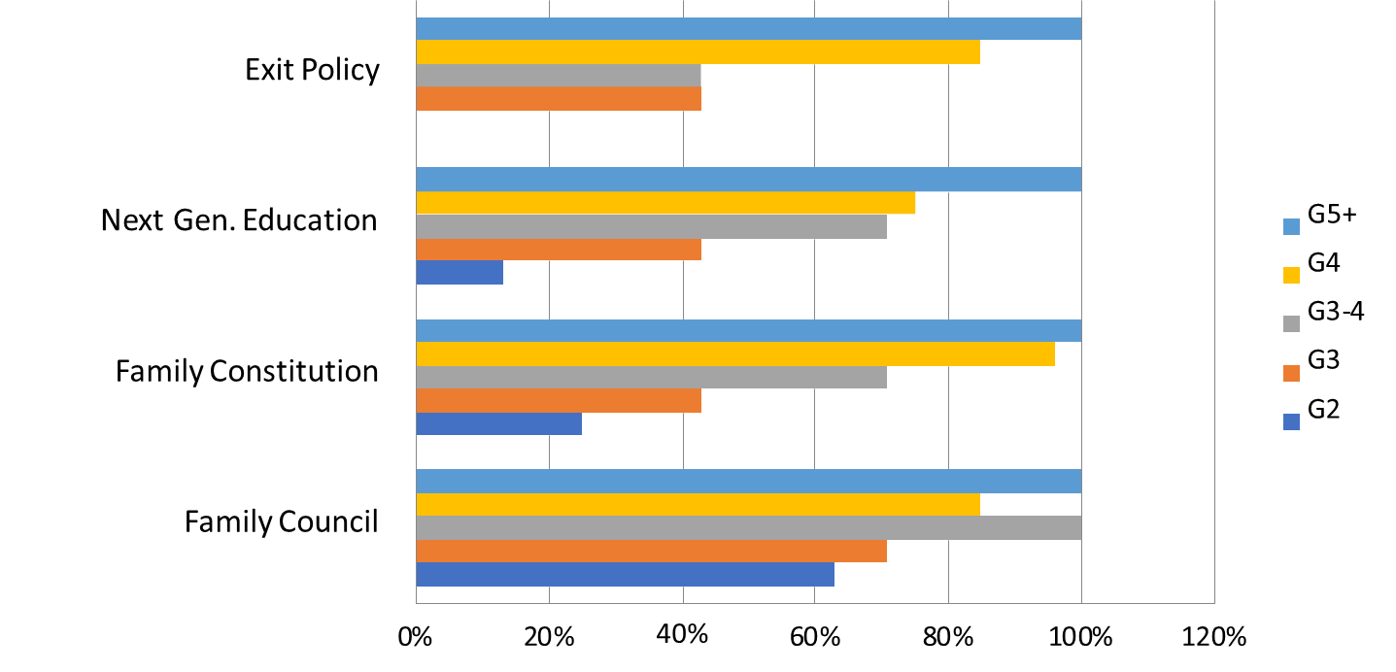
Education Promotes Family Sustainability
Governance for 100-Year Family Enterprises includes Rising Gen Education
Source: Dennis T. Jaffe, “Wisdom of 100-Year Family Enterprises: Evolving Family Governance Across Generations.” Presentation for FOX Family Learning Council. September 17, 2020.
Notes:
Talking Points
From Dennis T. Jaffe’s book, Borrowed From Your Grandchildren: The Evolution of 100-Year Family Enterprises – families that last beyond three generations place emphasis on family education

Slide 11
The Great Leadership Transfer
Source: 2019 FOX Family Office Benchmarking Report
Notes:
Talking Points
In addition to the great wealth transfer, there is also a great leadership transfer
62% of G1 members surveyed in the 2019 FOX Family Office Benchmarking Report within 4-6 years of a transition, were without a family learning program to support the transitions
Discussion Question:
Think about everything you plan for, spend money and time on. Now consider, what will happen if you pass money down to people who are unprepared for it?
If your rising gen were suddenly asked to assume leadership positions in the family in one year, what would they need to do and learn to get up to speed?

Slide 12
FOX Family Examples – Goals for Learning
Family Learning Aims To:
Produce family entrepreneurs
Develop committed, unified, knowledgeable shareholders
Engage, inform and foster a sense of ownership
Preserve family wealth while being philanthropic
Groom the next generation for succession management
Engage next gen & raise responsible children
“Families who defy the proverb of shirtsleeves to shirtsleeves in three generations recognize the value of their human capital and the importance of investing in the development of the people in their family enterprises.
…Every family that has someone serving in the capacity of a Chief Learning Officer is committed to growing great owners and beneficiaries who understand their unique gifts and opportunities to contribute to the collective family.”
- Jay Hughes, FOX Chief Learning
Officer Focus Group, 2017
Notes:
Talking Points:
Here are a few additional examples of family learning goals / why family learning is important from FOX members

Slide 13
Is Education a Core Value in Your Family?
Knows family’s definition of responsible ownership , creates newsletters, games and activities to engage kids on a regular basis. Developed an age matrix and other tools to standardize learning paths. Established new family member on-boarding program.
Sends people to education events and programs, asks advisors to talk to family members; no real plan in place for individuals to develop certain skills and competencies.
“Educates” family members at annual family meeting by having them attend the meeting.
Low
High
Has dedicated personnel or consultant with education/training competency to manage all aspects of family education. Family learning expectations are clear to participants
Responsibility for family education is not a priority. Talks about learning as a goal, but not committing to making it happen.
Family Office Staff is responsible for learning.
Families manage education initiatives in different ways based on overall family values OR values of the current family leadership.
Notes:
Talking Points:
This helps the family identify how they are actualizing (or not actualizing) education as a key value.
Are your education efforts aligned to the family vision or an area of opportunity?
Activity/Discussion:
Print this slide and give participants 3-5 minutes to mark an x on the chart to indicate where they currently fall on the spectrum and circle where they would like the family to be in the future.

Slide 14
“Any family that sees the learning as a COST, does not have the intention to avoid the (shirtsleeves to shirtsleeves) proverb.”
JAY HUGHES, WEALTH OF WISDOM PODCAST
Notes:
Talking Points:
Are you talking about learning as an expense or an investment in the family capital?

Slide 15
What Does Family Learning Entail?

Slide 16
Two Parallel Goals
Family learning develops the skills, attitudes, and behaviors of family members to:
Support family goals
Self-actualize
Definition of Family Learning
Family learning is the process of gaining knowledge and expertise that supports family members’ ability to personally thrive AND engage with the family enterprise.
Additional characteristics:
Involves more than one generation
Has clear learning objectives and outcomes
Can be formal (e.g. financial literacy course) or informal (fun, family activity)
To achieve those goals, we develop a family learning program and/or philosophy that focuses on our family’s core areas for sustainability. For many families, program pillars include financial literacy, philanthropy, personal leadership, entrepreneurship, and responsible ownership.
Notes:
Talking Points
Our definition of family learning implies that a family learning program has parallel goals of supporting the family goals as well as the individual’s ability to self-actualize.
In order to achieve those goals, we develop a family learning program that focuses on the family’s core areas of sustainability, which also promote individuals in living a purposeful life.
Some common pillars of family learning programs include financial literacy, philanthropy, personal leadership, entrepreneurship, and responsible ownership.
We also want to develop a program that caters to different learning styles, is flexible, multi-disciplinary, and has a curated list of experiences. We discuss best practices in greater depth a bit later.
Discussion Question:
What pillars do we want in family learning program? Think beyond what is listed in this slide!

Slide 17
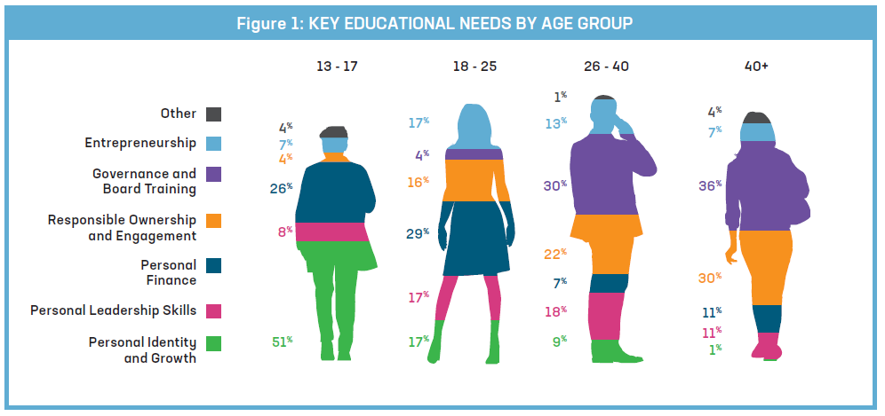
Components of a Successful Learning Program
Source: 2020 FOX Foresight Research on Continuous Learning
Notes:
Talking Points
This graphic provides a further example of what those education pillars might be and how you might focus on them at different ages.
Your learning program will consider that needs change with age, so this graphic can be a helpful guide to get a sense of how you might differentiate learning by age bracket
For example, you want adolescents to begin developing personal leadership skills – those skills that help individuals direct their own lives; as they move into adulthood, personal leadership becomes a much bigger focus that remains through mid-life, and then decreases in focus in late adulthood
Begin to think about what can be done internally, by the family or family office. What needs to be outsourced?

Slide 18
Family Learning Program Design Stages
 | Beginning Stage | Emerging Stage | Formalized Stage
Catalyst | Precipitated by a “why” event; engage consultant for facilitated brainstorming
Who Receives | Rising Gen, Family Leaders | Rising Gen, Family Leaders | All family, all ages, including children
Delivery | In-house | In-house and external (e.g. FOX programs, higher education, certifications, etc.) | In-house, external programs, video library, create own content, consultants
Structure | Informal, not tracked/managed | Connected to Education Committee, parameters created, define what is earned | Connected to family governance and family council, formal learning curriculum defined
Curriculum | Low-hanging fruit, foundational topics, or most urgent need | Real-time/most urgent needs, starting to define key content areas, including self-development | Established content areas matched with specific delivery, whole person and whole life education, self-actualization and soft skills
Evaluation | None | Anecdotal participant feedback | Participant feedback, surveys, consultant review, FOX benchmarking
When | Previously small, informal learning and/or at home, shifting to family meetings and organic discussions | Family meetings, organic discussions | Family meetings, rising gen retreats, committee meetings, junior board, governance structure
Notes:
Talking Points:
Family learning programs are as unique as the families they are developed for, but there are some general patterns to how families build these programs over time
Beginning Stage
Nascent stages of family learning
Making the case for education within the family
Bubbling interest; unsure where to begin
Little to no formal learning experiences underway
Education may be sporadic, on-demand, outsourced, or intermittent
Emerging Stage
Some family commitment to create or maintain a culture of learning
Programming exists and is growing
Working on formalizing the learning delivery
Family has identified core knowledge areas of importance for family learning
Current family leaders are proactively trained
Programs reacting to important and immediate family needs; real-time relevant learning
Formalized Stage
Strong learning program exists; growth or change is focused on maintenance and improvement to remain relevant
Family education focuses on the entire family, via group learning and individual learning
Curated set of programs (internal and external) and resources
Learning culture prevails across the enterprise
Family Learning Committee, consultants, advisors, and family office staff all committed to education efforts
Discussion Questions:
See next slide for an activity to answer these questions
Where do we land as a family?
Where do we want to be?
What do we need to do to begin or advance?

Slide 19
Application: Family Learning Program Design Stages
In the first row, list the actions you are currently taking and categorize them as beginning, emerging or formalized.
In the second row, brainstorm what actions you want to begin or advance.
In the third row, identify your next steps to move your actions in column two forward.
 | Beginning Stage | Emerging Stage | Formalized Stage
1. Current Actions
2. What to Begin or Advance
3. Next Steps

Slide 20
Best Practices for Family Learning
1.
Invest in the family as much as you invest in the business, your financial assets, and broader family enterprise.
2.
Use a programmatic approach to learning.
3.
Recognize the different learning styles
4.
Involve your students/learners in the development of the learning program
5.
Work with the family to outline the quantitative and qualitative core competencies that every family member needs
6.
Include time at a family meeting to complete an assessment
7.
Invite trained educators to lead the learning components of your family meeting
8.
Make it fun!
9.
Incorporate into every family meeting: time to share successes and challenges, balance of qualitative and quantitative learning, experts to teach content, a way to solicit feedback on the meeting
10.
Measure and report on your progress.
11.
Remain agile and adapt with the family.
Source: 2018 FOX Foresight
Notes:
Talking Points
While every family’s learning and development program will be unique and reflect the needs of its students, there are several best practices to which all can aspire. This list is culled from conversations with family leaders, industry educators, office executives who are struggling to find the time and resources to do this well, and next generation family members who want to learn.
Invest in the family as much as you invest in the business, your financial assets, and broader family enterprise. Your family’s human capital is your most precious asset; make sure that your budget allocation for learning reflects this.
Use a programmatic approach to learning that incorporates opportunities for individual, family group, and generational peer group learning. Learning is a process, not an event.
Recognize the different learning styles in your group and provide opportunities to learn in different ways (e.g., classroom, hands on/experiential learning, field trips, project work with opportunities to present learning/outcomes to the group).
Involve your students/learners in the development of the learning program to ensure that it resonates and meets them where they are (life stage, aptitude, and interest).
Work with the family to outline the quantitative and qualitative core competencies that every family member needs to flourish as individuals and within the family enterprise and include training on these competencies at every family meeting.
Include time at a family meeting to complete an assessment and have a trained facilitator work through the results with the group. Families who have used assessments report increased self-awareness, greater understanding and appreciation of their family members, and better communication across the family.
Invite trained educators to lead the learning components of your family meeting to enhance the learning.
Make it fun! Include fun activities and time for bonding as a group in every family meeting.
Incorporate the following into every family meeting:
Time for a roundtable check-in where family members can update the group on their progress and share successes and challenges
Balanced mix of quantitative and qualitative learning
Qualified, trained experts to teach the content and engage the family
System for soliciting feedback to improve future meetings and ensure that the meetings are achieving the learning goals effectively
Measure and report on your progress.
Remain agile and adapt with the family. Be prepared to stray from your curriculum to continuously meet the families changing needs.

Slide 21
“Don’t educate your children to be rich. Educate them to be happy, so they know the value of things, not the price.”
Victor Hugo

Slide 22
How Do We Develop a Family Learning Program?

Slide 23
Start with Family Goals
^{Continuation of Family} ^{Control of Companies}
Family Unity and Preparing Next Gen
^{Business}
^{Ownership}
^{and} ^{Control}
^{Sustained Purchasing}
^{Power Across Generations}
^{Family}
^{Continuity}
^{Wealth Preservation and Growth}
^{Family}
^{Philanthropy}
^{Lifestyle Protection and} ^{Transfer of Wealth to} ^{Future Generations}
^{Financial}
^{Security}
^{Impact and Rewards}
^{from Shared Giving}
Source: Family Office Exchange Research
Notes:
Talking Points:
The family enterprise is a unique type of entity. Each one has its own objectives that are as unique as the family that it supports. Family learning support the enterprise by developing the needed characteristics and behaviors in owners.
This slide shows 5 common family goals that benefit from educated family members.
Before drafting your family learning plan, it is important to review your family goals. This will ensure that you develop family learning goals and strategies that are supportive of the family’s broader objectives.
Discussion Questions
What are the goals of our family?
Can you think of a time when you had to make a decision in one of these areas and didn’t feel confident because of lack of knowledge on the subject area? What happened?
How might we build confidence of family members in key areas through family learning?
23

Slide 24
Define Family Learning Goals
Define Family Learning Goals, Expectations, and Risks
Review Goals in Context of Needs to Inform Learning Program Design and Delivery
Common Family Learning Goals:
Responsible Ownership & Stewardship
Financial Literacy
Personal Growth and Family Harmony
Preparation for Transition
Family Engagement
Source: 2018 FOX Family Learning Survey
Notes:
Talking Points
Once you have identified your family goals, you can define your family learning goals, expectations, and risks.
Common family learning goals include responsible ownership and stewardship, financial literacy, personal growth and family harmony, preparation for transition, and family engagement.
Considering your learning goals and needs of the family, you can then start designing a learning program
Work to create a culture of learning that is evident at family meetings, social interactions and all areas of the system.
Goals without expectations and specific direction are too ambiguous. Help the family members understand the reason for learning and be able to answer the “what’s in it for me” question. Be clear about why this is important.
Discussion Questions:
Considering our family goals, what family learning goals might we establish?
What are the main reasons you are starting a learning program?
What education will be most important (shareholder education, responsible ownership, financial literacy, family communication, personal leadership…?)

Slide 25
Example: Family Philanthropy Goal
Family Goal
Each family member is committed to creating positive social impact, in a way that is aligned with their individual strengths and interests as well as with the family’s values.
Family Learning Goal
Family members have developed personal interests, knowledge and skills to engage in family or personal philanthropy.
Program Design & Delivery
a) ages 5-18: participate in monthly community service
b) ages 19-25: join foundation junior board responsible for $100K in philanthropic giving
Desired Outcomes
a) Creation of a personal giving philosophy rooted in service and active participation
b)Value of giving back to the community is instilled
c) Foundational due diligence skills developed
Notes:
Talking Points:
Here is an example of how a family goal could be translated into a family learning goal, program/activity and the desired outcome the program seeks to achieve.
The goal looks at the broader family context as well as the individual impact. Allow for flexibility in delivery and how a goal is interpreted so that the participant feels empowered versus controlled.
Discussion Question:
Do any ideas for program design and delivery or desired outcomes arise after we have discussed family and family learning goals?
Think of a simple way to engage the family in a philanthropic project that promotes learning, cohesion and philanthropic goals.

Slide 26
Learning Goals from Families
Please describe the goals for your family learning and development program (n=55)
33% Responsible Ownership and Stewardship | “Develop family members and owners that make wise decisions in line with the founder's principles.” | “The primary goal is to prepare the third generation to grow into the roles their parents currently play as far as stewards of the family legacy and family assets.”
20% Financial Literacy | “To be able to read bank statements, tax returns and 10-K’s.To know what you own, how you own it, and why you own it. To have all of the appropriate estate documents.”
12% Personal Growth and Family Harmony | “Provide appropriate development opportunities for all generations in support of long-term viability and sustainability of the Family Enterprise.” | “Positive relationships among family members over the long-term.”
7% Preparation for Transition “To prepare the next generation for a successful wealth transition, related to the four pillars of wealth (social, intellectual, human and financial).” | 5% Family Engagement “We would be happy just getting them engaged, to be responsive.” | 4% All of the Above
Source: 2018 FOX Family Learning Survey
Notes:
Talking Points
This slide provides additional context regarding the common family goals from the 2018 FOX Family Learning Survey
Discussion Questions:
What are our family learning goals?
Which goals might be highest priority for getting started?
Brainstorm together: have family members write down their goals for a family learning and development program on a bunch of different sticky notes. Begin to categorize the sticky notes by theme, which will help you identify the areas of importance for the family, and be the start of a learning plan framework.

Slide 27
Learning Program Delivery Examples
The Drip, Drip, Drip Method
Distinguished from the conventional “water hose approach” to education, in which a young person, on coming of age, is sent to the trust officer to receive instruction, the drip, drip, drip method utilizes a carefully designed education plan employing family members, nannies, mentors, advisors and family office staff members in the education of children. This method includes:
Family talk (in a car, plane, over dinner)
Family traditions (retreats, meetings)
Family mentoring (aunts/uncles, family office staff)
Education programs (workshops, mentoring)
Source: Jolene Godfrey and Sara Hamilton, Preparing the Next Generation for the Responsibilities of Ownership, 2007
Top training opportunities for future family leaders n=44
Attendance at Board Meetings
Attendance at Advisor Meetings
Family Philanthropy
(e.g., research, site visits)
Participation in
Board Committees
Volunteering Together
Industry Forums
and Workshops
Source: 2018 FOX Family Learning Survey
Notes:
Talking Points
There are many different approaches to delivering education, from providing teachable moments on a regular basis to an intentional approach that may range from themed retreats once/year to a multi-year curriculum.
This slide provides examples of how some families deliver learning programs.
Additional opportunities for the younger generation to learn include:
Rising generation projects
Family office internship
Participation in due diligence
Informal coaching
Entrepreneurship club
Attendance at family and shareholders meetings
Discussion Question:
How have we delivered family learning to date?
What other ways might we delivery learning programs?
What opportunities exist to infuse family learning?

Slide 28
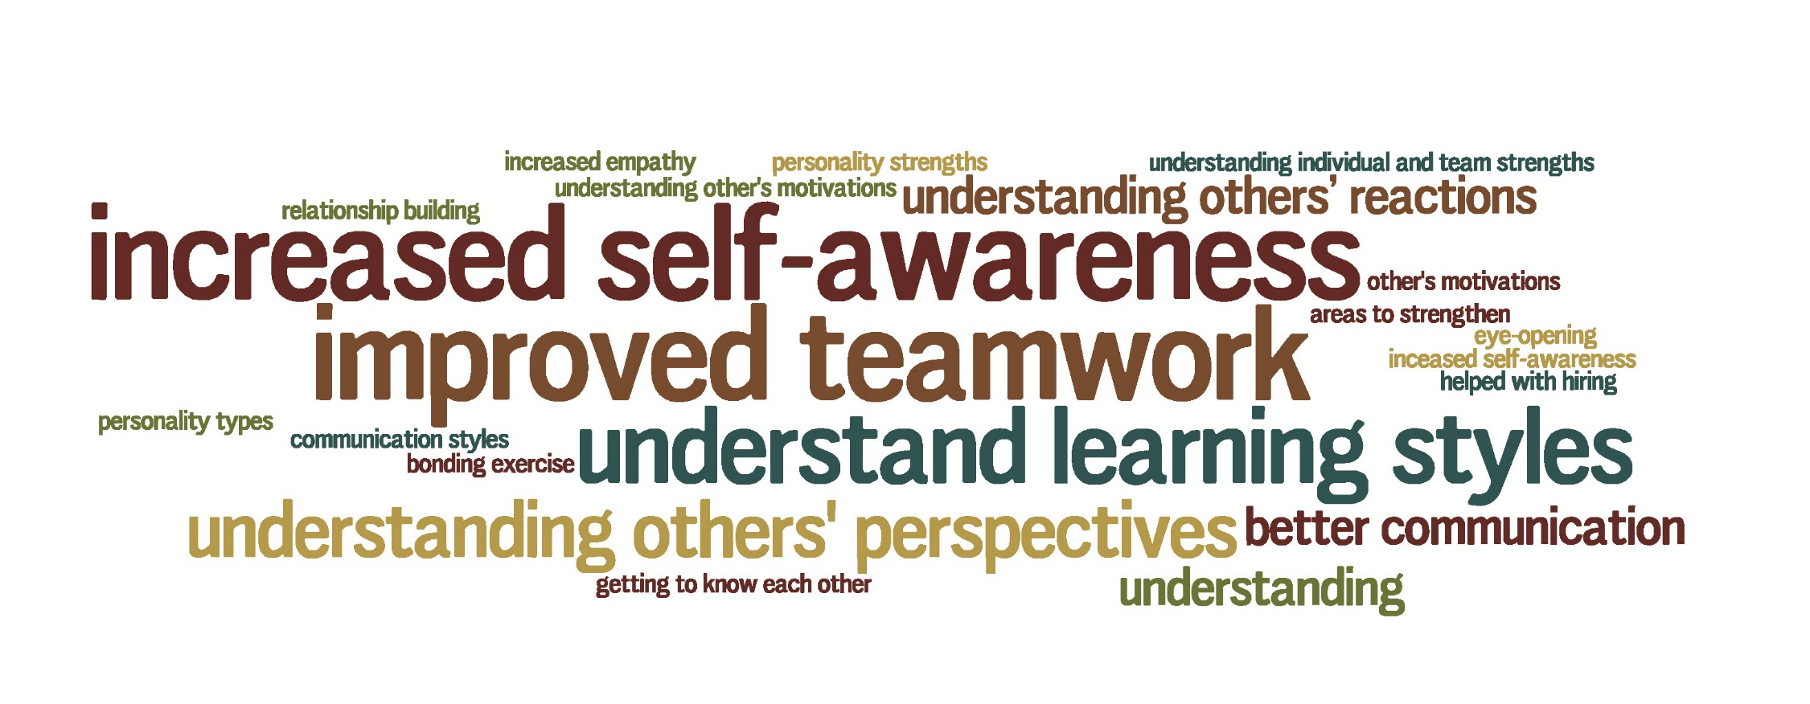
Using Assessments
Half of the participants in the 2018 FOX Family Learning Survey have used at least one personality, skills inventory or learning style assessment tool to help family members learn about themselves and each other.
How did this assessment(s) help the individual or family? n=30
Source: 2018 FOX Family Learning Survey
Notes:
Talking Points
Assessments can be a powerful tools:
Learn about yourself as an individual as well as the rest of your family members. Assessment provide a common language and tool to understand one another.
To gather data to inform the development of family or individual learning plans.
Used as part of a family learning program to achieve goals.
Families that have used assessments report that they helped to increase self-awareness, improve teamwork, build understanding of others’ learning styles and perspectives, etc.
Discussion Questions:
What experience do we have with assessments?
Are there any assessments you would strongly recommend (or want to avoid)?

Slide 29
Frequency of Family Learning
How often do you deliver learning and development programs to family members? n=44
Source: 2018 FOX Family Learning Survey
Notes:
Talking Points
Families also deliver learning programs at various frequencies.
Discussion Question:
How often does family learning currently occur (if at all)?
When we think about our ideal scenario, how often would programs be offered?

Slide 30
What Challenges Might Arise?
What is your greatest challenge related to educating family members? n=57
Source: 2018 FOX Family Learning Survey
Notes:
Talking Points
By anticipating barriers and mitigating risks we can amplify the success of our family learning program.
Discussion Questions
Do any of these challenges resonate with you?
What other challenges might we face in getting started with family learning?
How will we address these challenges?
How do our family goals and values inform how we will choose to respond to barriers?

Slide 31
“Ambitious families improve their odds of success by developing knowledgeable and capable leaders who understand the importance of a multi-generational legacy strategy.”
Mark Haynes Daniell & Sara S. Hamilton, Family Legacy and Leadership

Slide 32
How Do We Begin?

Slide 33
How to Begin
Plan for the Future
Set out to build a family learning program with an intentional methodology that will empower family members with the knowledge, skills, behaviors and attitudes to achieve personal and family ambitions.
Create an action plan and timeline for family learning program design and delivery
Starting actions may include further data/information gathering, a kickoff meeting, establishing a program design committee, etc.
“Our interviews of successful inheritors revealed a startling fact: Very few had received a textbook education in financial literacy. Rather, they learned by watching their parents: how they lived, what they talked about, what they valued, and what they didn’t value.”
Healthy, Wealthy & Wise, Coventry Edwards-Pitt
BUT
Start Today
Identify one step you will take this week to advance family learning.
Create a family blog/newsletter and write a first post
Identify an opportunity to share a family story that illustrates the family’s values with a member of a younger generation
Notes:
Talking Points
The most successful family learning programs will have an intentional methodology that includes a multi-year curriculum that builds upon topics year after year
However, the only way to start is to start. So let’s think about the actions we can take to start family learning today.
Discussion Questions:
How can we start building our family learning program of the future?
What actions can we take today, in the next week and next month to start family learning now?

Slide 34
Additional Examples to Get Started
Multigenerational Brainstorm
At the next family meeting, ask members for thoughts on the most important family education topics.
Physical Reminders of Family Culture & History
Capture a family phrase, set of values, or mantra on journal covers, wallet cards, or a special family pin.
Create Repeated Dates for Meetings
Having repeated, locked-in annual dates builds consistency and commitment.
Coloring Exercises for Children
Add logo (or something else) to newsletter that children can color and describe what it is and its importance to the family
Get an External Facilitator
Hire an external facilitator for your next annual family meeting who will help you drive learning and engagement.
Gather Additional Information
Conduct a survey to gather insights from the entire family to inform program design (see next slide).
Source: 2017 FOX Family Forum Presentation, “Preparing the Family for a Successful Future by Mitzi Perdue
Source: 2018 FOX Family Fall Enterprise Forum Presentation, “Why Resilient Families Hold Family Forums,” by Marianne Stillwell
Notes:
Talking Points:
This slide lists additional ideas for getting started.
Reference the FOX Family Learning Handbook for more content and ideas.

Slide 35
Examples of Additional Survey Questions
What would you like to learn in the next year?
Of these (multiple choice topics) which are most important for responsible shareholders? Which are most interesting?
How do you learn best?
What is a role you would like to play in the family, in the future? (Give list of options to prime their thinking, as well as a comment box for open responses)
When considering a role you would like to play, what do you need to learn to get there?
What will be the work of your generation?
Why is education important for our family in particular?
What do we most want to pass on to the kids and grandkids?
What does the shared vision of our future look like?
How do we integrate the rising generation into the family enterprise?
What does the rising generation need to know in order to be an effective owner of a family enterprise?
What are your hopes and concerns for your own kids related to these challenges?
What resources should the family office dedicate to learning? (Options, part time staff member, consultant, temp/contract staff, etc.
Notes:
Talking Points:
If you conduct a survey to gather additional information, this slide provides a list of questions that may be helpful in getting started.
These questions are also effective when having a family learning brainstorm session, a multi-generational discussion, or to cover in a family education committee meeting.

Slide 36
Insourcing versus Outsourcing
The majority of families enlist outside speakers and/or trusted advisors (e.g., consultants, trained facilitators, custodians, attorneys, investment professionals) to deliver educational content at family meetings/retreats.
Do you use outside speakers/consultants to deliver educational content to family members? n=60
57%
43%
YES
NO
The average FOX member works with 23 different trusted advisors, from accounting firms to investment consultants. These advisors understand the family and can be great teachers of technical topics at family meetings. Similarly, educators and outside consultants bring valuable perspective, objectivity, and experience to the learning process.
Source: 2018 FOX Family Learning Survey
Notes:
Talking Points:
A robust family learning program will include experiences managed by the family and family office as well as experiences that are outsourced.
A family office cannot be expert in everything, so leverage its strengths and hire experts for opportunities best offered externally.
Discussion Questions:
Who is currently in our network that we can leverage for family learning?
What are we able to currently deliver in house?

Slide 37
How FOX Can Help
FOX is the industry-leading membership community for successful families, family office executives and trusted advisors who are tackling the unique challenges of generational wealth. The FOX Learning Center provides coaching, individualized and group learning, and consulting to family members through experienced, professional educators who can serve as outsourced Chief Learning Officers for your family enterprise.
FAMILY GROUP LEARNING
INDIVIDUAL LEARNING
PEER LEARNING
Individual Learning Plan & Personalized Coaching
Certified Facilitators Trained in Multiple Assessment and Inventory Tools
FOX Thought Leadership and Research Studies
Webcasts, Blogs, Video Learning and Podcasts
Family Enterprise Planning
Annual Family Meeting Planning & Facilitation
Customized Family Learning Program
Workshops to Develop Skills and Apply Knowledge
FOX Forums
Rising Gen Leadership Program
Regional Dinners and Virtual Meetings
Rising Gen Network
Family Learning Network
Personal Connections with Peers and Like-minded Members
ROOT CAUSE ANALYSIS
A way to uncover the origin of the problem

Slide 38
“The secret of getting things done is to act!”
Dante Alighieri

